Slide 1
CSS and html – guide to basics
AKA, “Oh no! You can’t use Bootstrap!”

Slide 2
Contents
Why Learn the Basics?
Resources
Best Practices
Where to Start?
Questions

Slide 3

Why Learn the Basics?
You might not be able to use a pre-establish CSS framework
Avoid copyright or legal issues
Strict In-House coding standards
Understanding the basics will allow:
You to create custom styling
Build upon existing CSS frameworks
Debug issues in conflicting styles

Slide 4
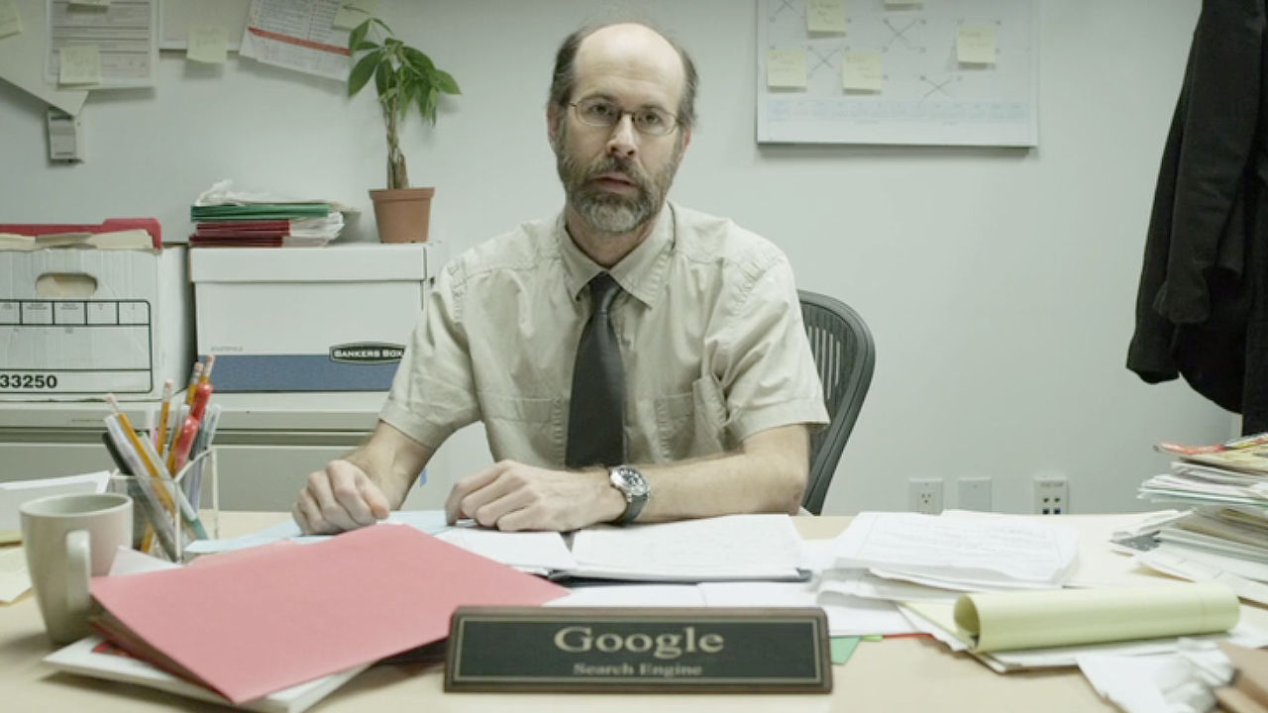
Resources
W3 Schools
XHTML (more on this in a bit)
Web Searches
Google
Yahoo
Ask Jeeves
Alta Vista

Slide 5
Resources (Cont.)
Design
Book: The Design of Everyday Things
Don Norman
Typography
Color Theory
Advance User Interface

Slide 6
Best Practices

Slide 7
Where To Start?

Slide 8
Questions?

